Slide 1
The Weekend Navigator
Session 4
Good Stuff to Know to Keep Out of Trouble

Slide 2
The Weekend Navigator
Tides & Currents

Slide 3
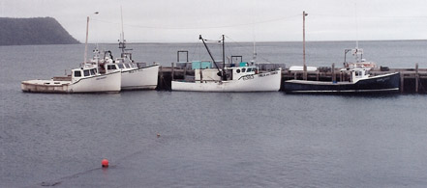
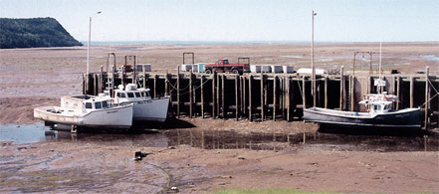
Tides and Tidal Currents
Tides: Vertical motion of water
Tidal Currents: Horizontal motion of water
Notes:
Bay of Fundy. From: http://oceanservice.noaa.gov/education/kits/currents/02tidal2.html

Slide 4
Information Sources
Tide and Tidal Current Tables:
Formerly NOAA publications
Now private, specialty publications
Newspapers & local publications
Television & radio weather
Online
GPS units
Computer programs

Slide 5
What We Know About Tides and Tidal Currents
They are periodic and predictable
Hour-by-hour
Day-by-day
Season-by-season
Year-by-year
Result from gravitational effects of moon & sun
BUT . . . also affected by wind, rain, atmospheric pressure

Slide 6
Tidal Terms
High Water (HW) & Low Water (LW) – Maximum & minimum height of tide
Tidal Range – Height difference between consecutive high and low waters
MLLW – Datum for “zero” tide and depth soundings
MHW – Datum for overhead clearances & heights
Notes:
The abbreviations HW and LW are taken from the NOS Tide Table book.
From http://www.nauticalcharts.noaa.gov/csdl/learn_datum.html
NOAA’s nautical charts have depths referenced to mean lower low water (MLLW), and bridge clearances are referenced to mean high water (MHW). The legal shoreline in the U.S., which is the shoreline represented on NOAA’s nautical charts, is the MHW shoreline; that is, the land-water interface when the water level is at an elevation equal to the MHW datum.

Slide 7
Moon & Sun Effects
Gravitational pull of moon and sun creates a tidal bulge
Opposite side bulges to establish equilibrium due to centrifugal forces
Force of sun only 44% that of moon due to distance
Tidal day matches the lunar day—
24 hrs 50 min
N
EARTH
MOON
SUN

Slide 8
Tidal Range Variations
Sun & Moon in Alignment (Syzygy)
During full or new moon
Maximum tidal range
“Spring” tides
SUN
MOON
EARTH
MOON

Slide 9
Tidal Range Variations
Sun & Moon not aligned (in quadrature)
During half moon
Minimum tidal range
“Neap” tides
MOON
SUN
EARTH
MOON

Slide 10
Principal Tidal Patterns
Diurnal: (Pensacola, FL)
Cycle of one lunar day - one high and one low tide.
Semidiurnal: (Boston, MA)
Cycle of one-half lunar day - two highs and two lows.
Mixed: (San Francisco, CA)
Large inequality in height of two highs or lows.
Notes:
A lunar day is 24 hrs and 50 min.
On the graphs, each vertical line represents a solar day, 24 hrs.
The horizontal lines are tide levels in feet and the red “0” line represents MLLW.
Very evident is that most tides at LW are above MLLW.

Slide 11
Importance of Tide Info
Safety:
Avoid running aground
Choosing among alternate routes
Clearance:
Sufficient room under a bridge?
Anchoring:
Determine scope of anchor rode
How much swing room is needed?
Tying to a Dock:
Amount of slack needed in lines

Slide 12
How to Predicting Tides
Use NOAA tide tables
Select State
Select major waters
Select detailed water location
Interpret tide information from graphs

Slide 13
Notes:
Over 3000 subordinate stations are listed with the differences from the reference stations already applied.
This and subsequent screens depict “drilling down” through the pages to get a specific subordinate station’s tidal data.

Slide 14
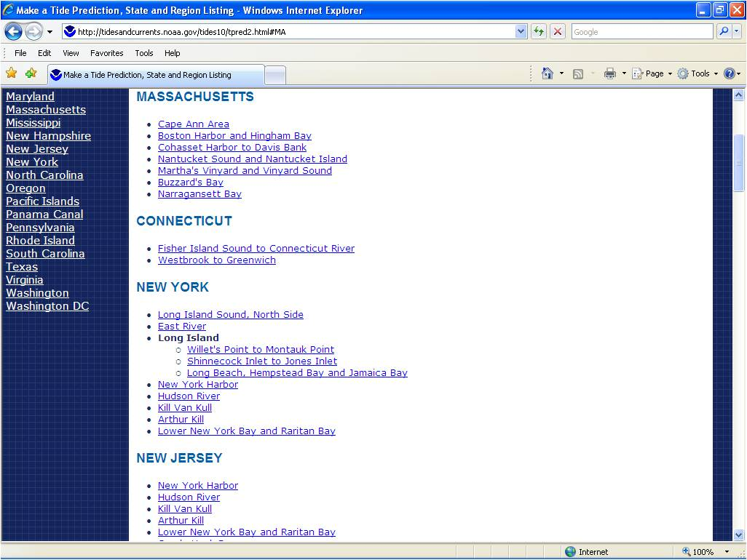
Notes:
Drilling down

Slide 15
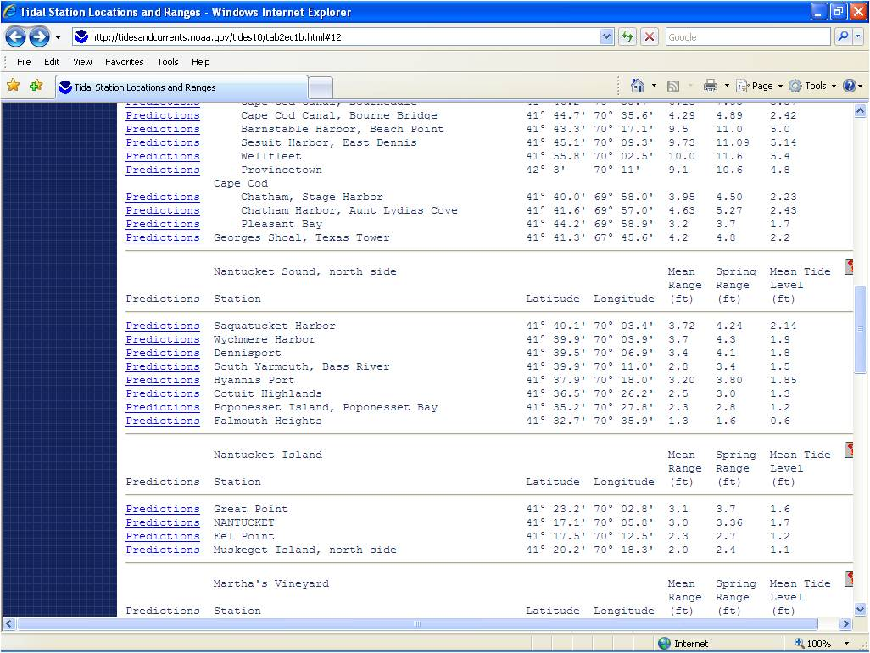
Notes:
Drilling down

Slide 16
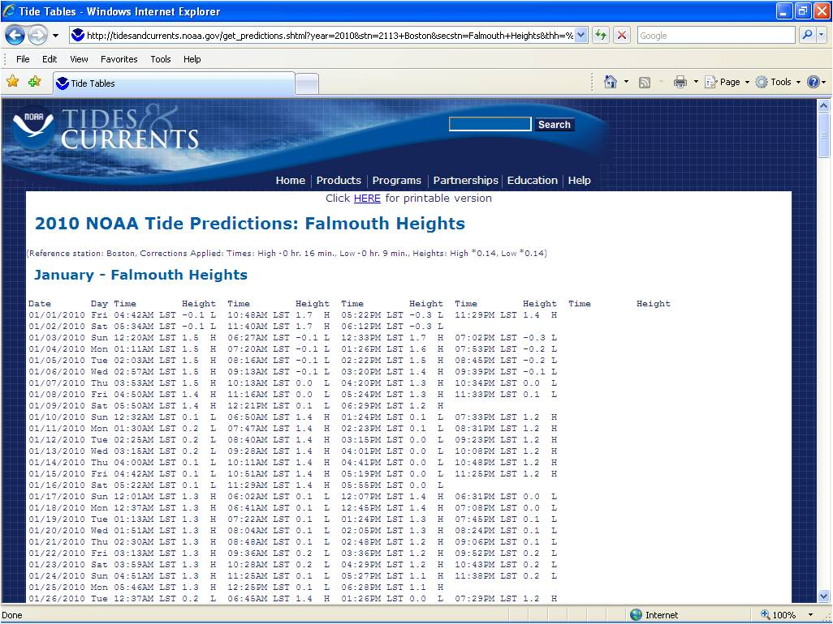
Scroll down to February
Notes:
Drilling down

Slide 17
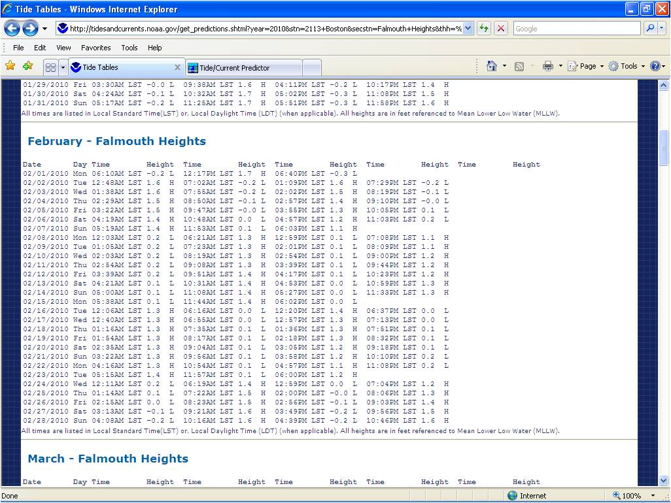
Notes:
2 Feb HW is at 1309, 1.6’.

Slide 18
Interpret Tide
Notes:
Any date can be chosen

Slide 19
Software For Tide Predictions
GPS / Chartplotters usually have this capability
Computer programs give quick and easy picture of day’s tidal pattern

Slide 20
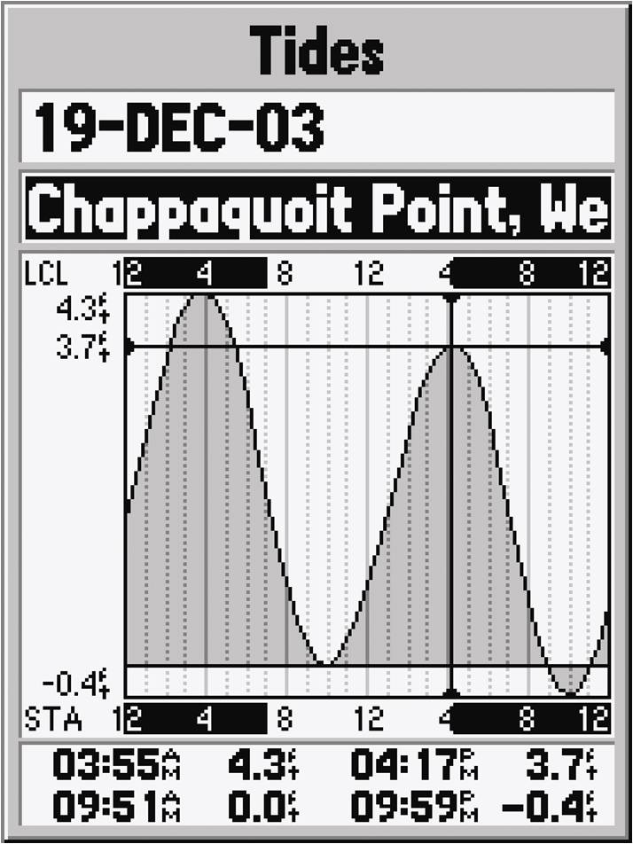
GPS Tide Data Feature
GPS options include tidal charts
Tide heights & currents

Slide 21
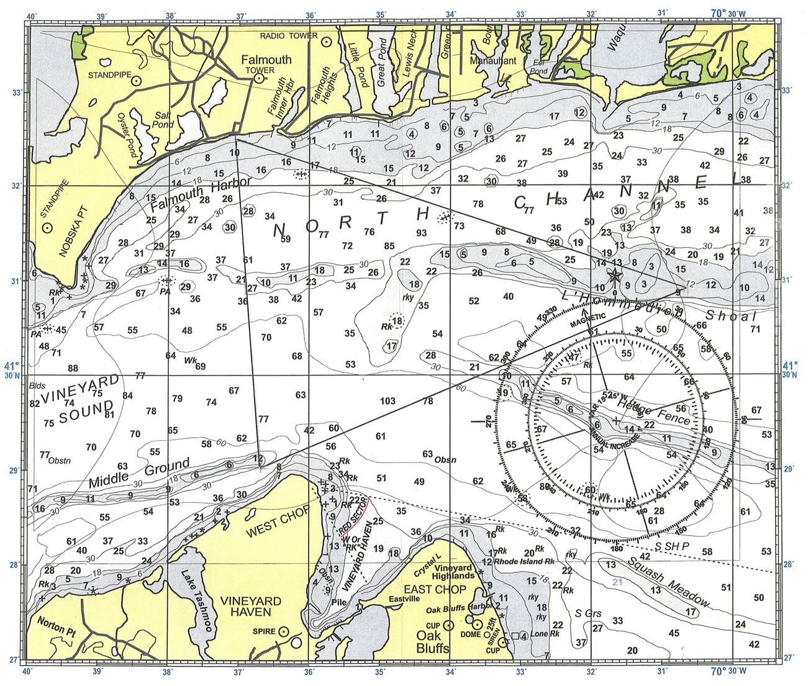
1300 GPS
1353
C 304 M
S 15.0 D 4.9
1333
S 15.0 D 3.5
C 190 M
C 082 M
S 15.0 D 4.8
1314
If HW prediction at Falmouth Hts. is 1.0’ at 0805, about how deep will the water be in the red circle?
Notes:
Under average meteorological conditions, HW will be about 4 + 1 or 5’. But, it’s a prediction; don’t bet the farm on it.
Relate water depth to MLLW and height of tide.

Slide 22
Height of Tide using Rule of 12ths
1, 2, 3, 3, 2, 1 = 12
HW
LW
These 6 numbers represent 6 equal time periods between HW and LW (or vice versa)
And add up to 12
Notes:
This is a memory device for the rule.
For semidiurnal tides the time period is about six hours.
For diurnal tides the time period is about 12 hours.

Slide 23
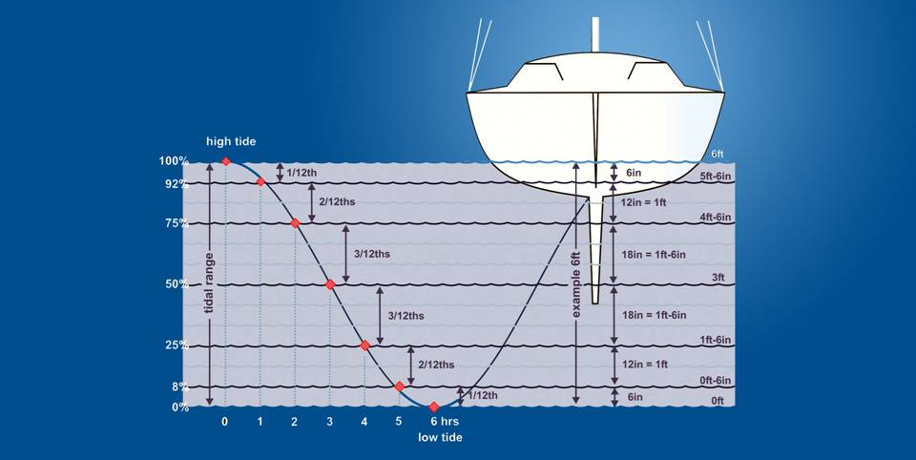
Height of Tide using Rule of 12ths
Height of Tide using Rule of 12ths
Fig. 14-11A
Notes:
The rule is just an estimate. It demonstrates that tide changes are non-linear during the tide cycle. This is more critical for areas with large tides. It’s also critical for very large draft ships where a few inches will determine whether the boat can traverse a channel.

Slide 24
Tidal Current
Horizontal flow of water
due to tide

Slide 25
Effects of Tidal Current
Tidal currents of only 1 or 2 knots can critically affect your voyage
Fuel consumption planning
Course to steer
Speed made good
Set and Drift

Slide 26
Basic Current Determination
Current has characteristics of:
Direction: Set
Speed: Drift
Actual direction and speed of vessel:
Direction: CMG
Speed: SMG
1500
Set 120º M
Drift 1.5 kts
CMG 075 M
1500
C 065 M
SMG 7.0
S 6.0
1400
Notes:
Current sailing is beyond the scope f the course, but introduce the students to the graphical result (resultant) of set and drift.

Slide 27
Class Exercise- Set & Drift
Use Chart 2
The fix you made at 1312 has you off the DR course line
This was caused by current
What is the set & drift?

Slide 28
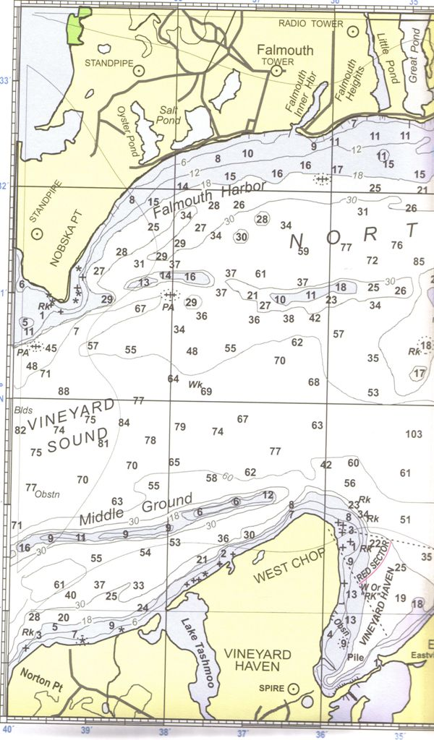
1300 GPS
1312
025 M
Session 2 DR plot and Session 3 fix
Off course due to current and wind
C 190 M
S 15.0
1312
326 M
1312
1314
Notes:
Plot the 1312 DR position.

Slide 29
1300 GPS
1312
025 M
1312 DR position
What’s the direction and distance to the fix?
C 190 M
S 15.0
1312
326 M
.
1312
1312
1314
Notes:
Plot the 1312 DR position.

Slide 30
1300 GPS
1312
025 M
Set = 067°
Moved 0.25 nm during 12 min pd.
Speed??
60D ST
60 x 0.25 = 15
15/12 = 1.25 kn
Drift = 1.25 kn
C 190 M
S 15.0
1312
326 M
.
Notes:
Fix and DP position labels removed for clarity.
GPS will inform you of this drift during the journey
If this journey was continuing on the same course in a larger body of water, a trained navigator can alter the course to compensate for the set/drift.

Slide 31
1300 GPS
1353
C 304 M
S 15.0 D 4.9
1333
S 15.0 D 3.5
C 190 M
C 082 M
S 15.0 D 4.8
1314
How will that current affect the remaining legs?
Notes:
The set and drift will be different at each location. Do not assume it’s the same.
GPS Go-To screen tells you the leeway -how the boat is drifting.
Remember--leeway is caused by tidal current and the wind

Slide 32
Tidal Current
Flood: Flow from seaward
Ebb: Flow toward seaward
Slack: Period of minimum / no current
On tables as “Minimum before Flood (or Ebb)”
Flood & ebb designations sometimes arbitrary in canals, between islands, etc.
Time of slack water usually NOT same as time of high or low tide
Notes:
Time of slack water usually NOT same as time of high or low tide:
At HW and LW, the “stand of tide,” the water level stops rising or falling, but that does not mean the tidal current stops or reverses.
In most coastal locations the time of slack water is not coincident with max flood.
In the example we’ve presented for Falmouth Heights , HW is 1309, but slack water at the nearest current station
, NW end of L’ Hommedieu Shoal, is at 1340.
This situation is graphically explained in the Additional Slides: Standing Wave, Progressive Wave, and Something In-between.

Slide 33
Viewing Current Tables

Slide 34
Notes:
Drilling down

Slide 35
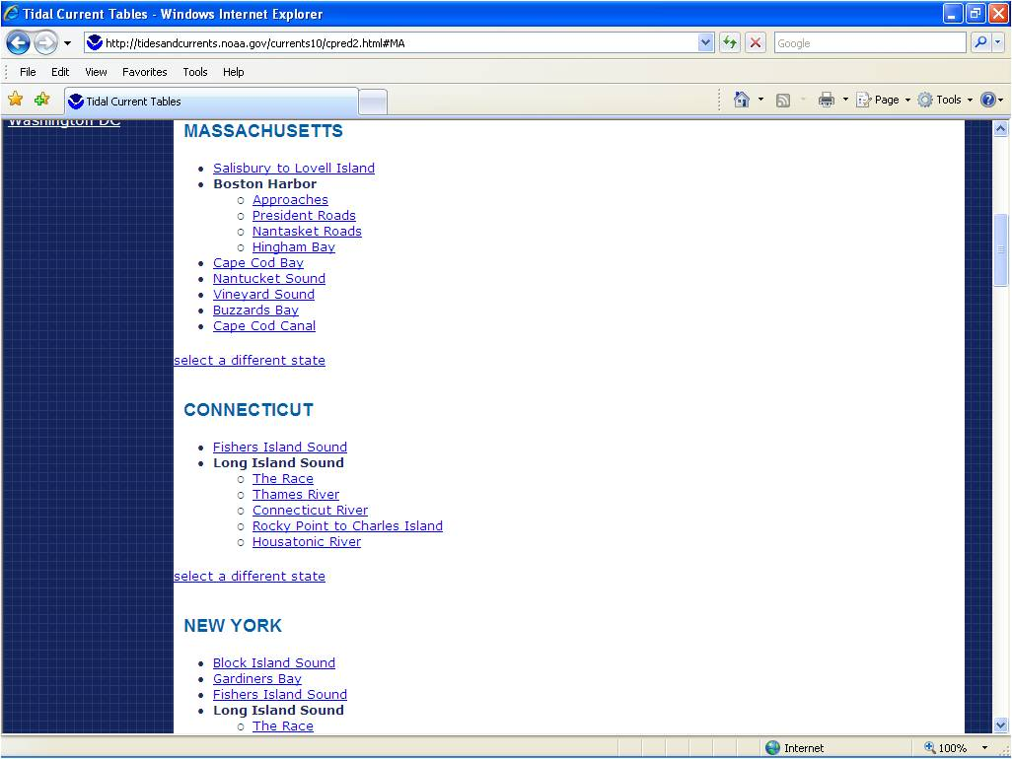
Notes:
We’ll look at both sounds to find the subordinate station closest to our area of operation.

Slide 36
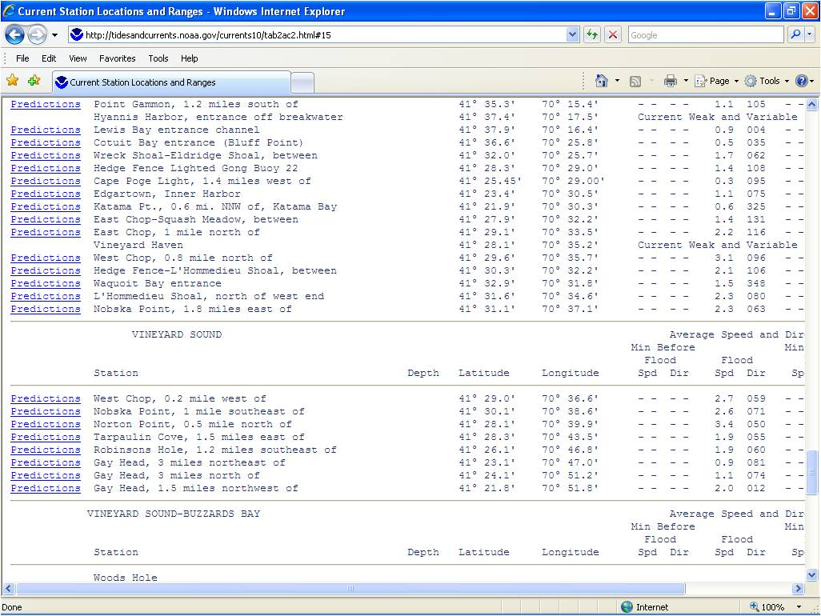
Scroll down to Penikese Island
Notes:
A multitude of subordinate stations over our AO. We’ll illustrate the technique by using the NW end of L’ Hommedieu Shoal as the selection

Slide 37
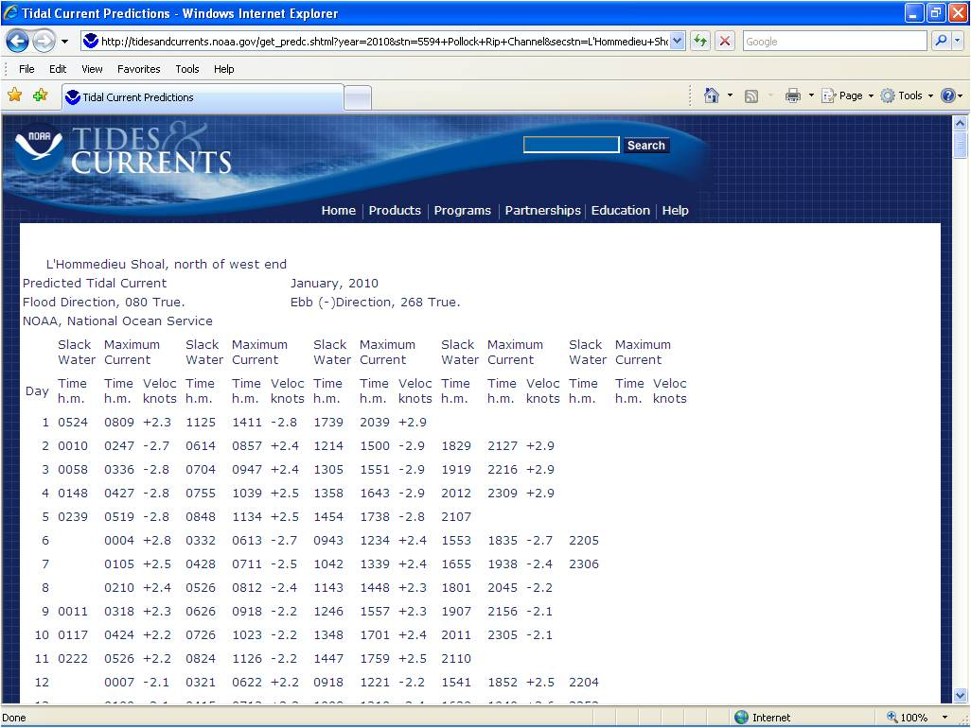
Scroll down to February
Notes:
Talk through what is happening at these times.

Slide 38
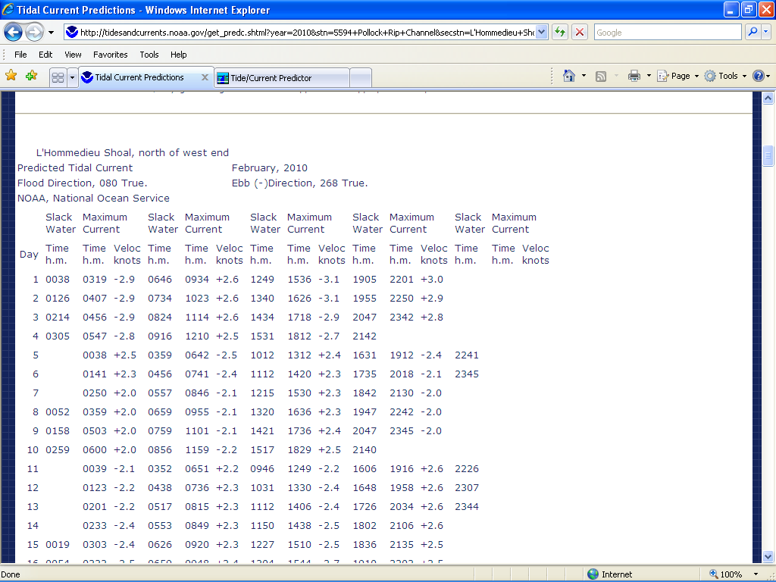
Notes:
Note that tide directions are expressed in True degrees.

Slide 39
Keeping Track & Double Checking
Set and drift can be estimated:
Observation of water flow around stationary objects
Boat’s SOG and wake
Calculated as-you-go using DR & fix
Coast Pilot also provides useful data and information on currents
Remember, current is seldom constant across a body of water
Notes:
SOG- Speed over the ground.

Slide 40
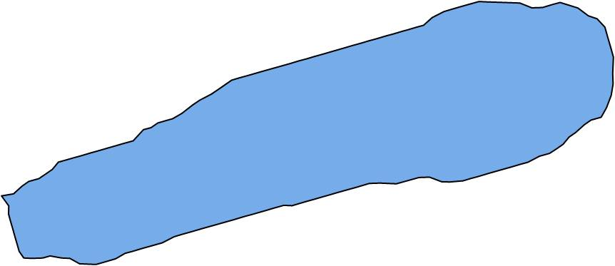
Wind and Waves
Wave height depends on
Wind strength
Wind duration
Fetch (distance)
Buffalo
Lake Erie
Toledo

Slide 41
Wind, Waves & Currents
These factors can be additive
Calculated to get the end result- called “leeway”
Rarely can all three be exactly measured
Vector calculations to measure leeway not emphasized in this course
GPS can help you stay on course using crosstrack error (XTE) function
Notes:
In traditional navigation, water currents, wind drift and steering errors (characterized on this slide as affected by wave action) are all considered “current” for set and drift calculations. That concept is not addressed in the text, so, for presentation purposes, they are lumped together as “leeway.”
The actual vectors can be calculated using a “maneuvering board.”
Use of XTE for staying on course was discussed in Session 3.

Slide 42
Avoiding Danger
There are dangerous waters ahead!
Establish a Danger Bearing
Determine a visual object to use
From the object, draw a bearing that separates safe waters from dangerous
Stay outside of that Danger Bearing
Make the object a waypoint and use GPS as a backup
Be Careful with the numbers!
Notes:
Explain Danger Bearing using the next slide
Nearly 100% of errors in measuring and plotting any bearing ,and especially danger bearings (e.g., NMT or NLT), are due to carelessness.

Slide 43
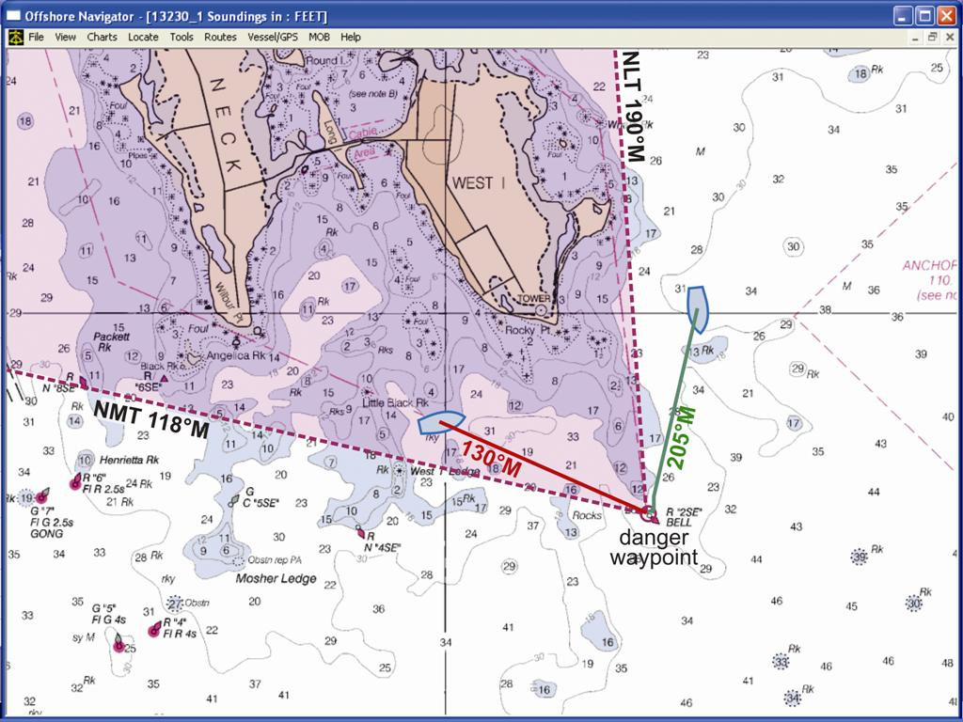
Danger Bearings
Avoiding Danger
Notes:
Discuss the technique for determining NLT/NMT and labeling given in Fig. 7-7.

Slide 44
Class Exercise-Danger Bearing
Use Chart 1
Blue vessel’s intended course, 205 M, is in orange.
Remain clear of the rocks east of Dutton Point by setting a danger bearing using the Tower at 41° 31.6’ / 070° 39.7’.
Notes:
If there is a time constraint, consider assigning this exercise as homework.

Slide 45
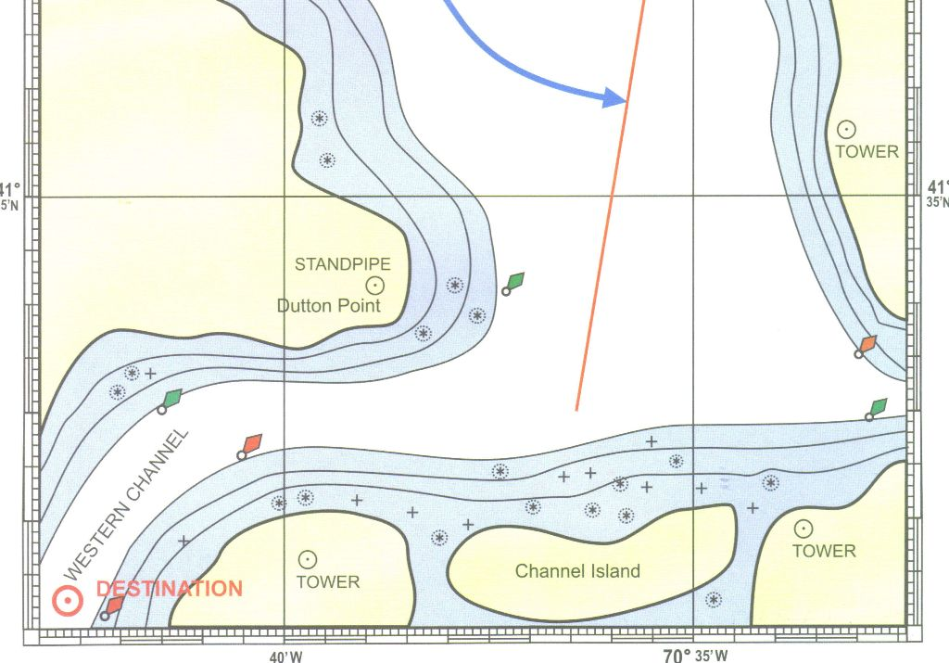
Notes:
Since the SW portion of the M rose is congested and difficult to read for this bearing, a better result can be achieved by measuring the bearing using the NE portion and calculating the reciprocal.
If time remains, could discuss using the danger bearing as an LOP for a fix as the Tower to the east comes abeam.

Slide 46
NLT 233 M
Notes:
Since the SW portion of the M rose is congested and difficult to read for this bearing, a better result can be achieved by measuring the bearing using the NE portion and calculating the reciprocal.
If time remains, could discuss using the danger bearing as an LOP for a fix as the Tower to the east comes abeam.

Slide 47
Danger Circle
Establish a waypoint that’s in the center of the danger area
Establish the radius that avoids all danger
Enter these data into “Avoidance Area” GPS feature
Avoid steering in this area- or set alarm
Notes:
This can be presented using Fig. 7-8 on the next screen

Slide 48
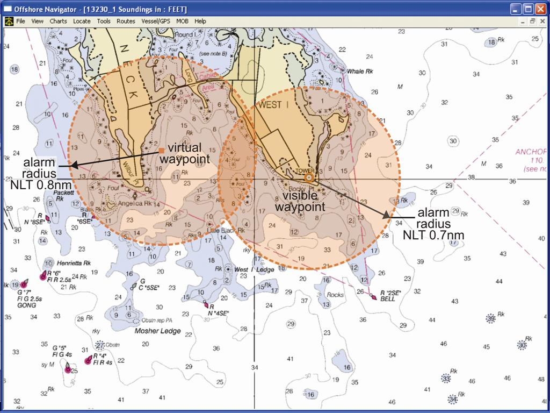
Avoiding Danger
Danger Circle

Slide 49
The Weekend Navigator
Homework for Session 4
Chapters 16-19 & 26
Notes:
Discuss homework and expectations for next session. If time remains, do some more chart work or work another tide problem.

Slide 50
The Weekend Navigator
Additional Slides

Slide 51
Class Exercise-Set & Drift
Use the second leg of the DR plot on Chart 2.
You depart your brother’s recommended spot (a GPS fix at 41° 29.0’ / 070° 36.7’) at 1700 proceeding along the DR course 082°M at 10 kts STW.
At 1715 you take the following bearings with a hand bearing compass:
Nobska Pt Standpipe- 302 M
Oak Bluffs Cupola- 195 M
Plot the 1715 fix and determine the current’s Set and Drift

Slide 52
The Weekend Navigator
Additional Slides
1715
1715
302 M
195 M
1715
1715
1715
GPS

Slide 53
The Weekend Navigator
Additional Slides
1715
1715
302 M
195 M
1715
1715
1700
GPS

Slide 54
Set = 330°
Moved 0.5 nm during 15 min pd.
Speed??
60D ST
60 x 0.5 = 30
30/10 = 3.0 kn
Drift = 3.0 kn
1715
1715
302 M
195 M
1715
1715
1700
GPS

Slide 55
Height of Tide using Rule of 12ths
1, 2, 3, 3, 2, 1 = 12
HW
LW
These 6 numbers represent 6 equal time periods between HW and LW (or vice versa)
And add up to 12
Notes:
This is a memory device for the rule.
For semidiurnal tides the time period is about six hours.
For diurnal tides the time period is about 12 hours.
The abbreviations HW and LW are taken from the NOS Tide Table book.

Slide 56
Height of Tide using Rule of 12ths
1, 2, 3, 3, 2, 1 / 12
HW
LW
During the 1st time period, the tide will fall (or rise)
1/12th of the tidal range
Notes:
Using a falling tide as an example since the Fig. 14-11A graph is set up that way.

Slide 57
Height of Tide using Rule of 12ths
1, 2, 3, 3, 2, 1 / 12
HW
LW
During the 2nd time period, the tide will fall (or rise)
2/12^{ths} of the tidal range

Slide 58
Height of Tide using Rule of 12ths
1, 2, 3, 3, 2, 1 / 12
HW
LW
During the 3rd time period, the tide will fall (or rise)
3/12^{ths} of the tidal range
Notes:
.

Slide 59
Height of Tide using Rule of 12ths
1, 2, 3, 3, 2, 1 / 12
HW
LW
During the 4th time period, the tide will fall (or rise)
3/12^{ths} of the tidal range
Notes:
.

Slide 60
Height of Tide using Rule of 12ths
1, 2, 3, 3, 2, 1 / 12
HW
LW
During the 5th time period, the tide will fall (or rise)
2/12^{ths} of the tidal range

Slide 61
Height of Tide using Rule of 12ths
1, 2, 3, 3, 2, 1 / 12
HW
LW
During the 6th time period, the tide will fall (or rise)
1/12th of the tidal range

Slide 62
Here’s How It’s Done
Refer to Fig. 14-7A, pg 158.
Based on the Boston tide table for June 1st, use the rule of 12ths to predict the height of tide at 1300?
Tidal range: 10.1’ (HW) to 0.1’ (LW) = 10.0’
6 hrs between 0915 & 1519 = 1 hr each time pd.
(1) 0915-1015 (2) 1015-1115 (3) 1115-1215 (4) 1215-1315 (5) 1315-1415 (6) 1415-1519
1300 falls into the 4th period
1, 2, 3, 3, 2, 1 = 12
1 + 2 + 3 + 3 = 9 ÷ 12 = 0.75
0.75 x 10.0’ = 7.5’
10.0’ – 7.5’ = 2.5’ (about) at 1300
Notes:
Using the Rule of 12ths:
Write out the memory device.
Determine the tidal range.
Count up the hours between HW & LW (rounding is okay). Obviously, in regions of semidiurnal tides, the 6 time periods will usually be about 1hour each. In regions of diurnal tides, the 6 time periods will be about 2 hours. In locations where that’s not true, the time within in a period can be obtained by dividing the total number of hours by 6.
The target time (1300) falls into the 4th time period.
From the memory device, add up the first 4 numbers.
Divide by 12 and multiply the result by the tidal range.
Subtract the 7.5 from the 10’ range.
The result is approximately 2.5’. This is only an estimate!
If teaching this rule in a region of diurnal tides, modify the problem to reflect your local conditions. In those cases each time period will be a bit over 2 hours. See the diurnal problem in the “Additional Slides” at the end of the presentation.
If time permits at the end of the session, there are two Class Exercises (for diurnal and semidiurnal) for practice using the Rule of 12ths in the “Additional Slides.”

Slide 63
Class Exercise- Rule of 12ths
Refer to Fig. 14-7A, pg 158. Based on the Boston tide table for June 2nd, use the rule of 12ths to predict the height of tide at noon? (semidiurnal)
A bit less than 8’
Tidal range: 10.2’ (HW) to -0.1’ (LW) = 10.3’
6 periods between 1009 & 1610 = 1 hr each period
(1) 1009-1109 (2) 1109-1209 (3) 1209-1309 (4) 1309-1409 (5) 1409-1509 (6) 1509-1610
1200 falls into the 2nd period
1, 2, 3, 3, 2, 1 = 12
1 + 2 = 3 ÷ 12 = 0.25
0.25 x 10.3’ = 2.57’
10.2’ – 2.6’ = 7.6’ (about) at 1200

Slide 64
Class Exercise- Rule of 12ths
Based on the Pensacola, Fl. tide table for June 2nd, 2003, (extracted below) use the rule of 12ths to predict the height of tide at 1800? (diurnal)
HW at 1114 1.7’ LW at 2255 -0.4’
About 0.5’
Tidal range: 1.7’ (HW) to -0.4’ (LW) = 2.1’
6 periods between 1114 & 2255 (11hr 41 ≈ 12) = 2 hrs each pd.
(1) 1114-1314 (2) 1314-1514 (3) 1514-1714 (4) 1714-1914 (5) 1914-2114 (6) 2114-2255
1800 falls into the 4th period
1, 2, 3, 3, 2, 1 = 12
1+2+3+3 = 9 ÷ 12 = 0.75
0.75 x 2.1’ = 1.57’ (round to 1.6’)
2.1’ – 1.6’ = 0.5’ (about) at 1800

Slide 65
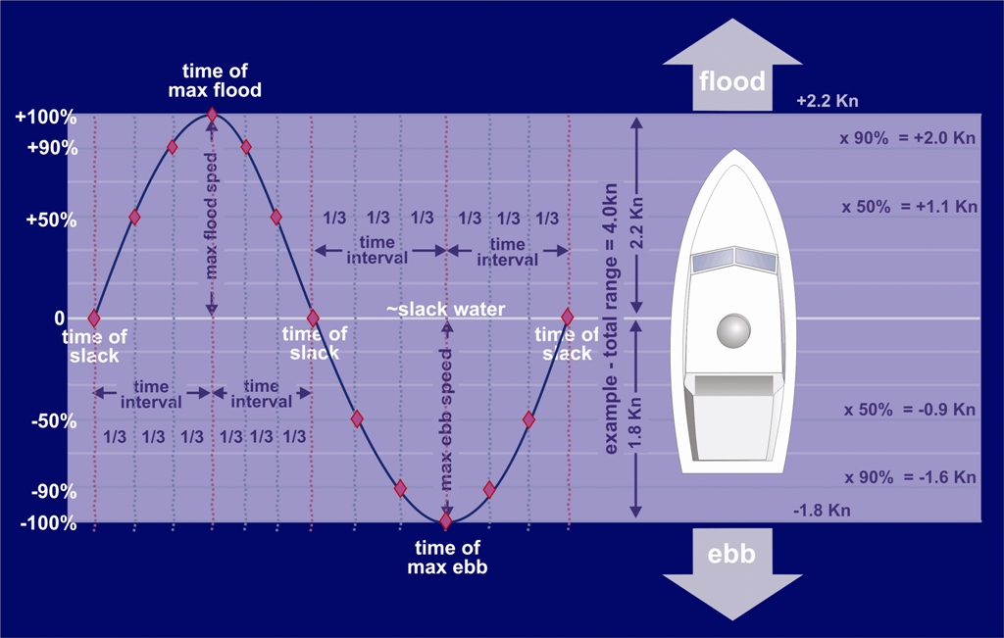
Current Speed using 50-90 Rule
Insert Fig. 14-15A
Notes:
Calculations for this rule are not as straight forward as the rule of twelfths, so no effort is made here to go beyond informing students that it’s available.
As always, it’s the instructor’s option to go into more detail and to work-up a class exercise. This would be useful in regions that experience high current velocities.

Slide 66
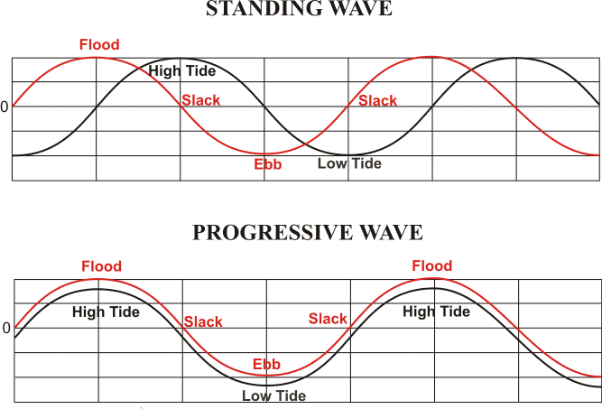
Relationship Between Tide & Current
Current Speed Graph
Tide Height Graph
MLLW
& Zero Speed
6 hr. Time Periods
Notes:
From http://tidesandcurrents.noaa.gov/faq2.html#10
Many professional and recreational users of tide and tidal current information have a "rule of thumb" to assume a relationship between the times of high/low tides and the times of the currents. That the times of slack water will be at the same time as the high and low tides, and that the flood and ebb current will occur between the high and low tides. Unfortunately, this assumed "rule of thumb" does not hold for most locations.
The relationship between the times of high/low tide and the times of slack water or maximum current is not a simple one. There are three "base case" conditions.
The first is a "standing wave" type of current. In a standing wave the times of slack water will be nearly the same time as the high and low tides, with the maximum flood and ebb current occurring mid way between the high and low tides. Standing wave conditions are most common at the head (most inland point) of larger bays and harbors. Boston Harbor slack times are about 30 minutes before HT and at LT.
The second is a "progressive wave" current. In a progressive wave, the maximum flood and ebb will occur around the times of the high and low tides, with the slack water occurring between the times of high and low tide. Progressive currents are most common at the oceanic entrance to many bays and harbor.
Most areas of the coast will fall somewhere in between a progressive and standing wave current. The exact relationship between the times of high and low tides and the maximum current or slack water is unique to each location and cannot be determined from a generic "rule of thumb".
The third case is a "hydraulic current". In a hydraulic current, the current is created by the difference in height of the tides at two locations joined by a waterway. The current will be at its maximum flood or ebb when the difference in the two heights are the greatest. The slack water will occur when the height of the tide at the two locations in nearly the same. Hydraulic currents occur at a limited number of locations. Some examples are: The Chesapeake and Delaware Canal, which connects the Chesapeake Bay and Delaware Bay, the East River in New York, which connects Long Island Sound to New York Harbor, and certain sections of the Intra Coastal Water Way (ICWW) between barrier islands which create different tidal conditions on opposite sides of the island

Slide 67
Relationship Between Tide & Current
Current Speed Graph
Tide Height Graph
MLLW
& Zero Speed
6 hr. Time Periods
HYDRAULIC CURRENT

Slide 68
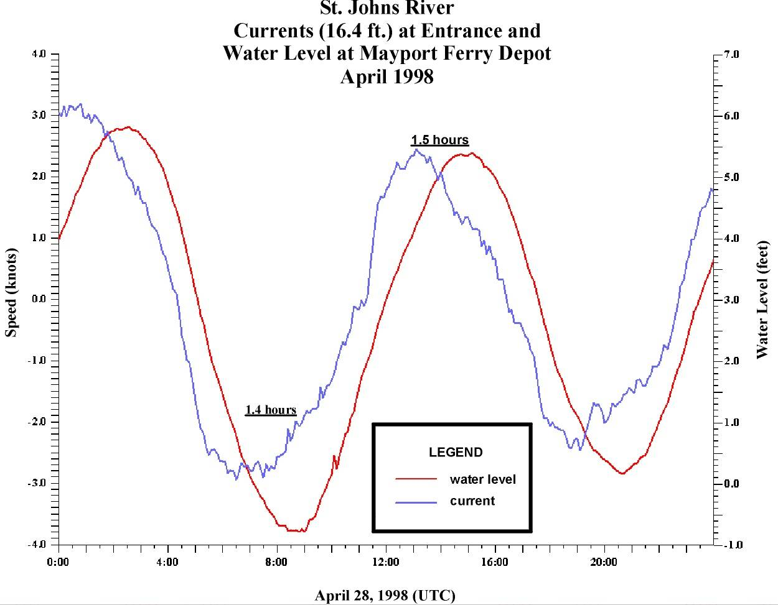
Something In-between
Notes:
most coastal locations fall somewhere between the standing and progressive wave.

Slide 69
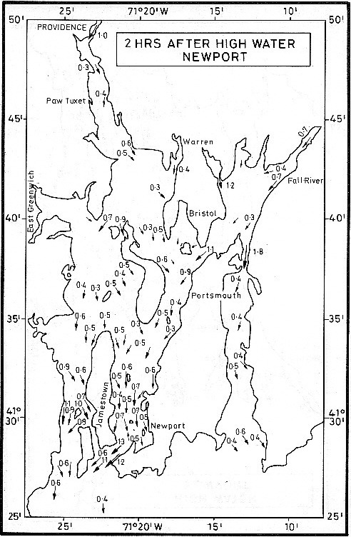
Tidal Charts
Commercially published in sets for selected bodies of water
A set consists of one chart for each hour in the tidal current cycle
Simply consult the chart for the time of interest
Notes:
Not available from NOAA or online. Consult Reed’s Nautical Almanac.

Slide 70
The Weekend Navigator
End Additional Slides
Notes:
The Rule of 12ths problems can be used as a class exercise or assigned as homework.

